Slide 1

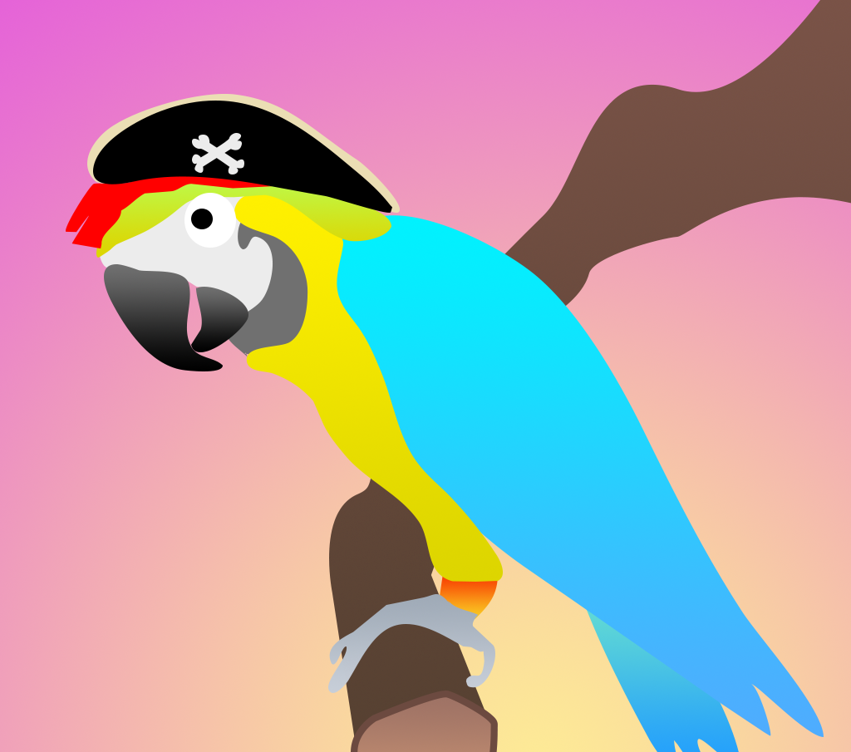
Memoarrr!
Mark van Dam
Cosmin Harsulescu
Clemens Kaiser
Mart Berends

Slide 2



Agenda
The Game
The App
The Model

Slide 3
The Game

Slide 4


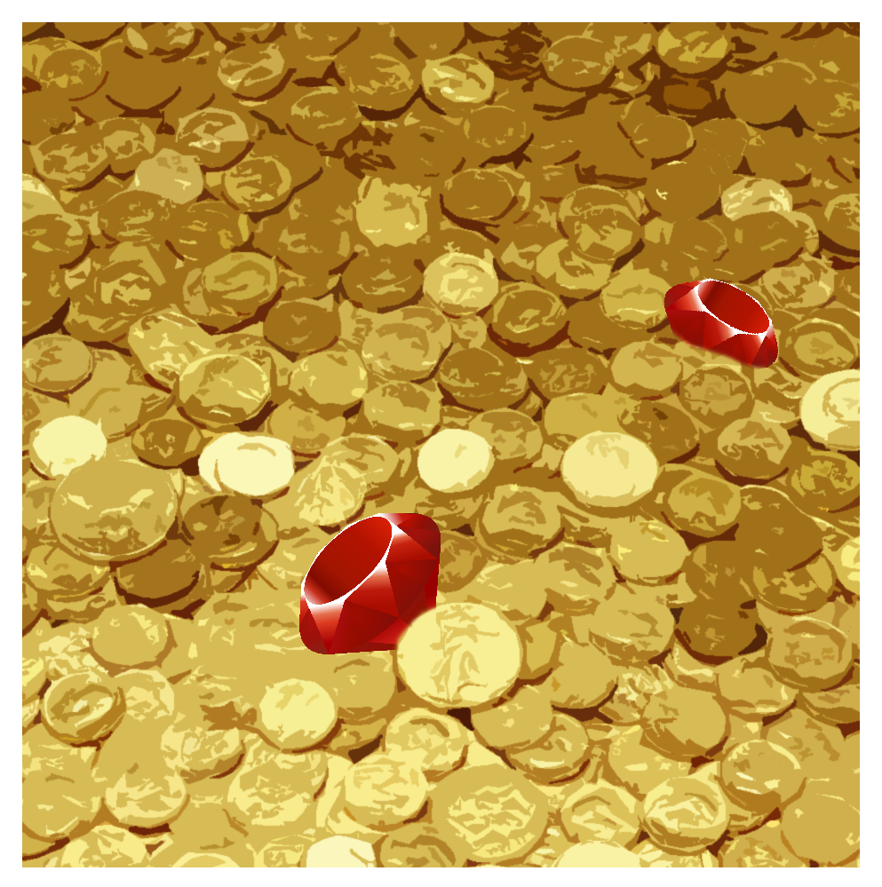
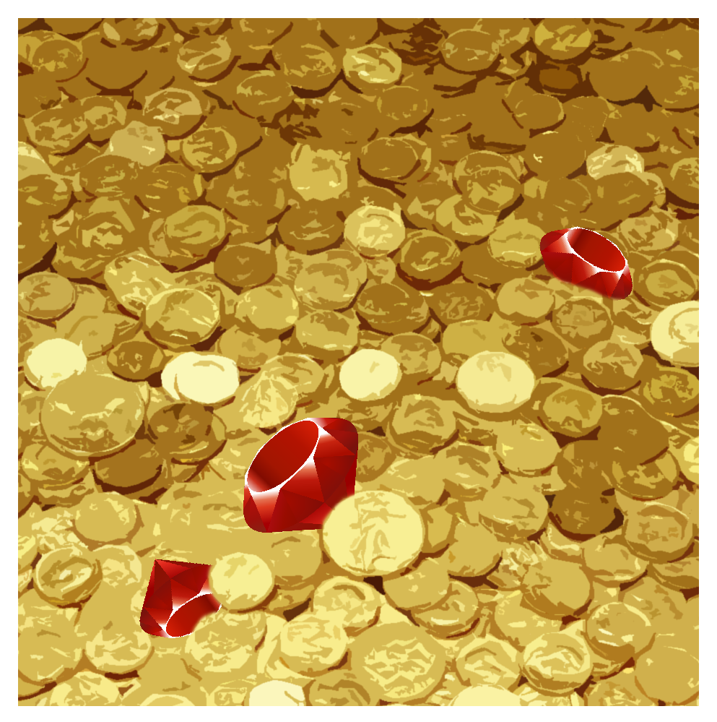
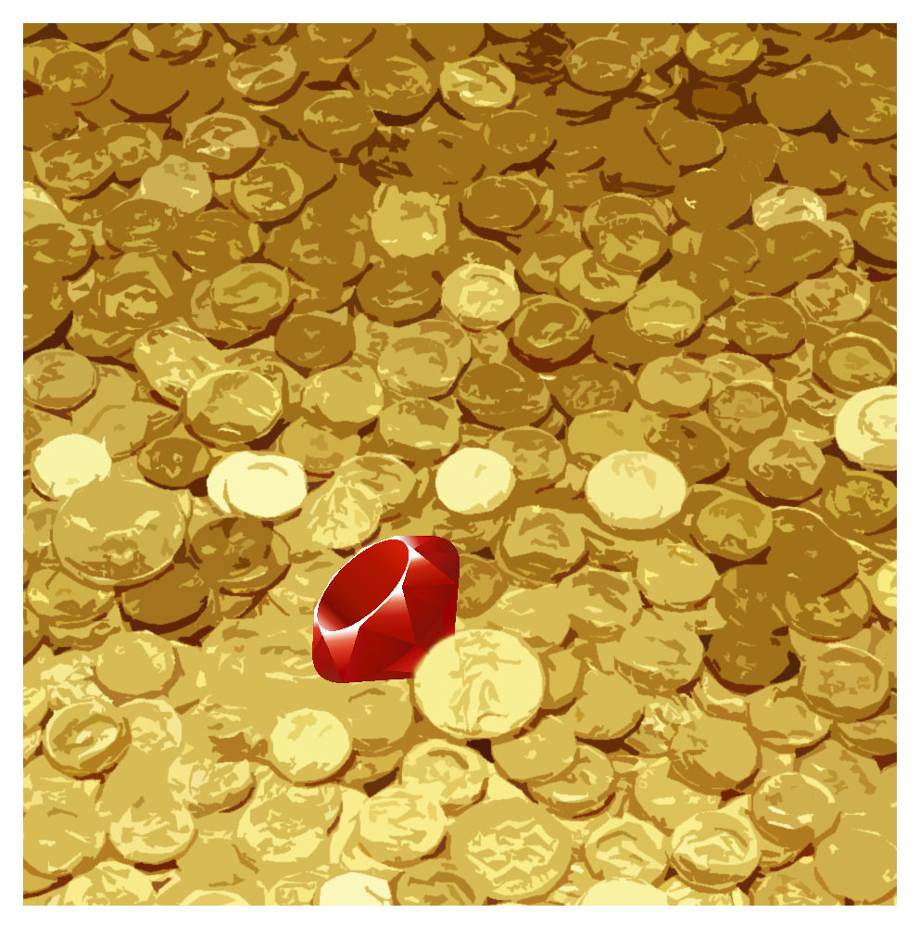
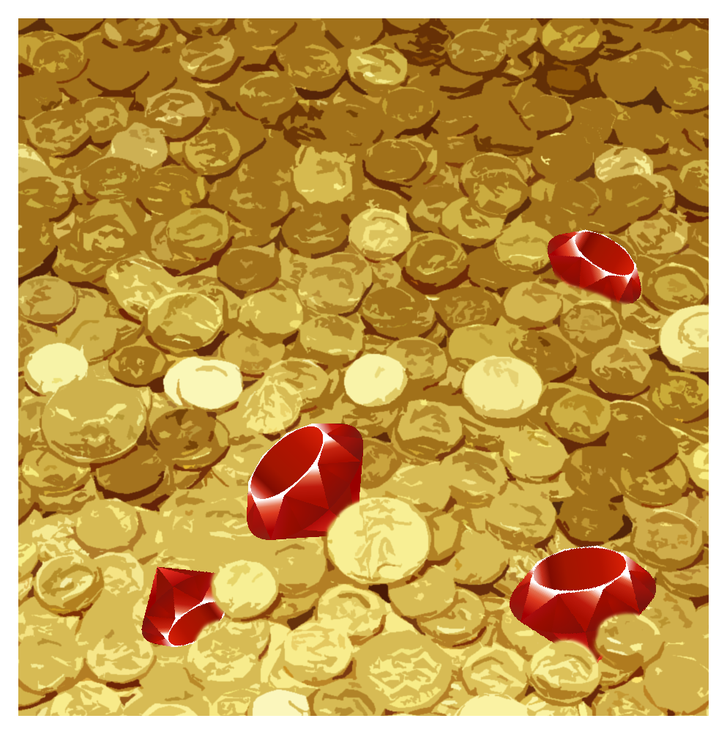



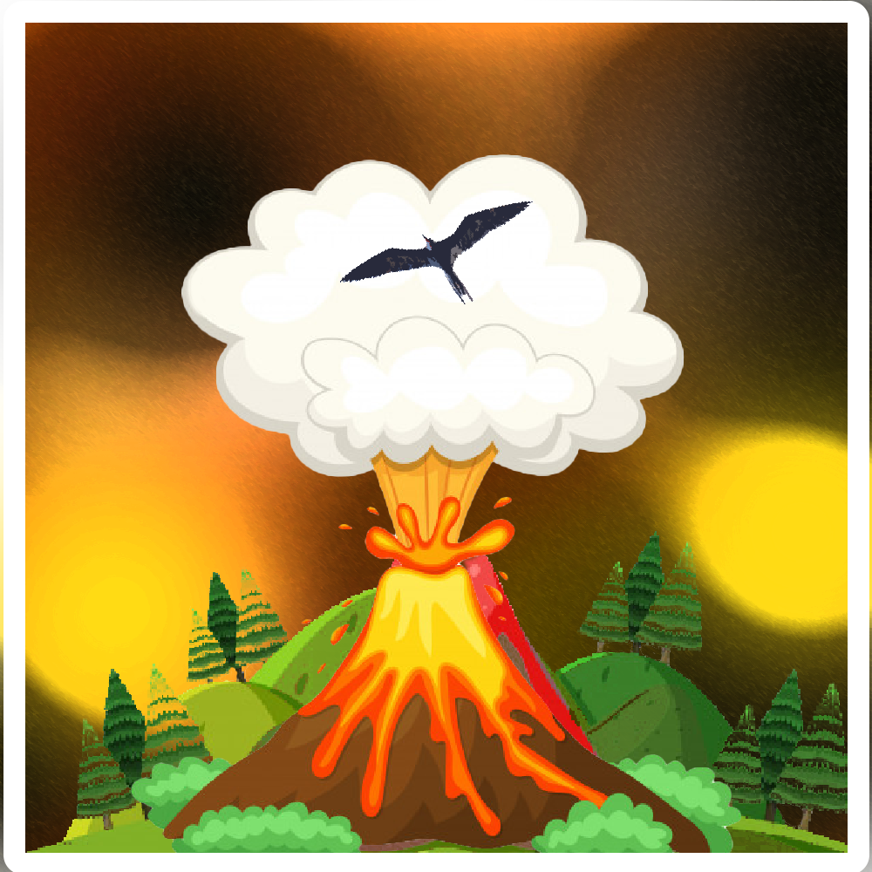
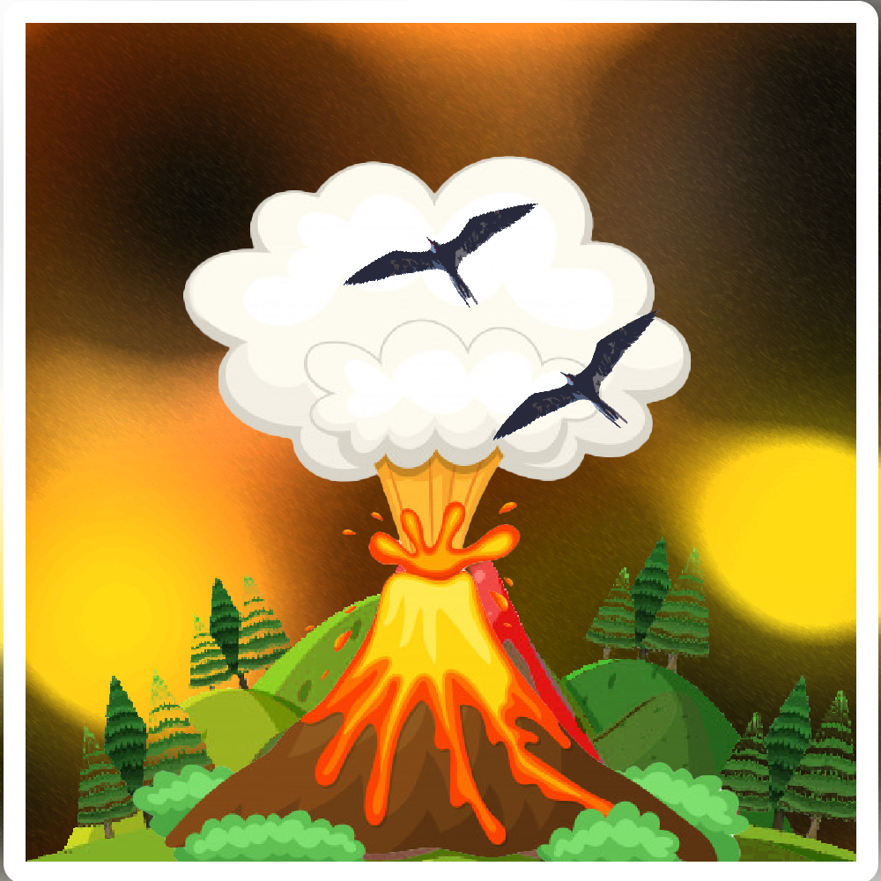


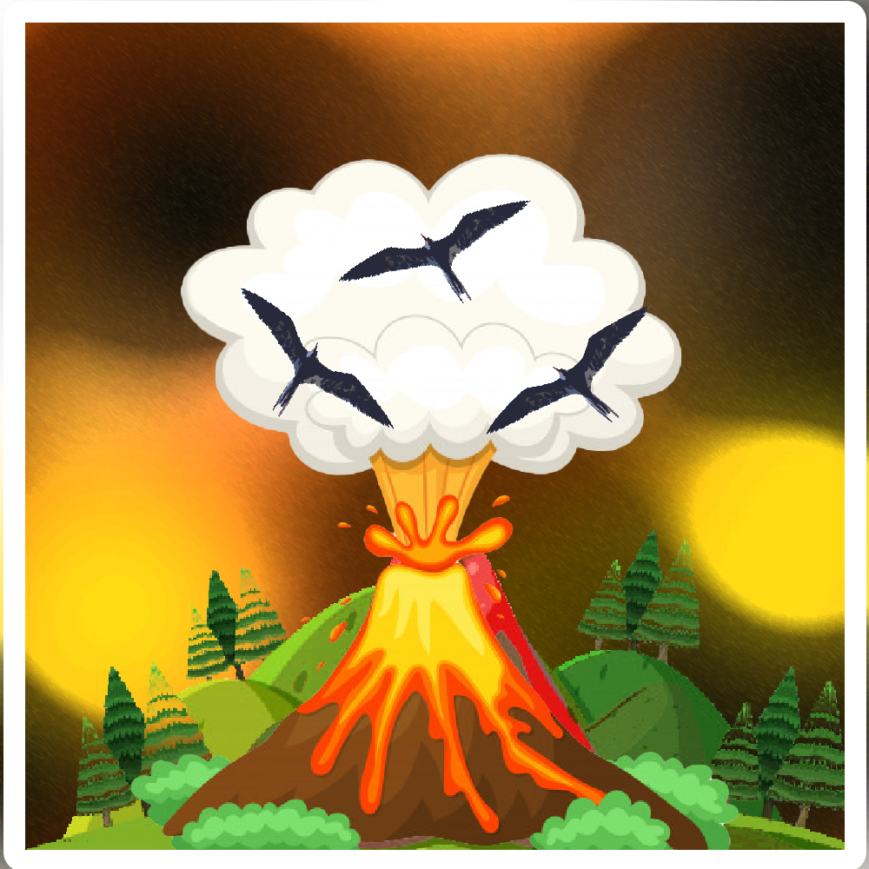

Slide 5
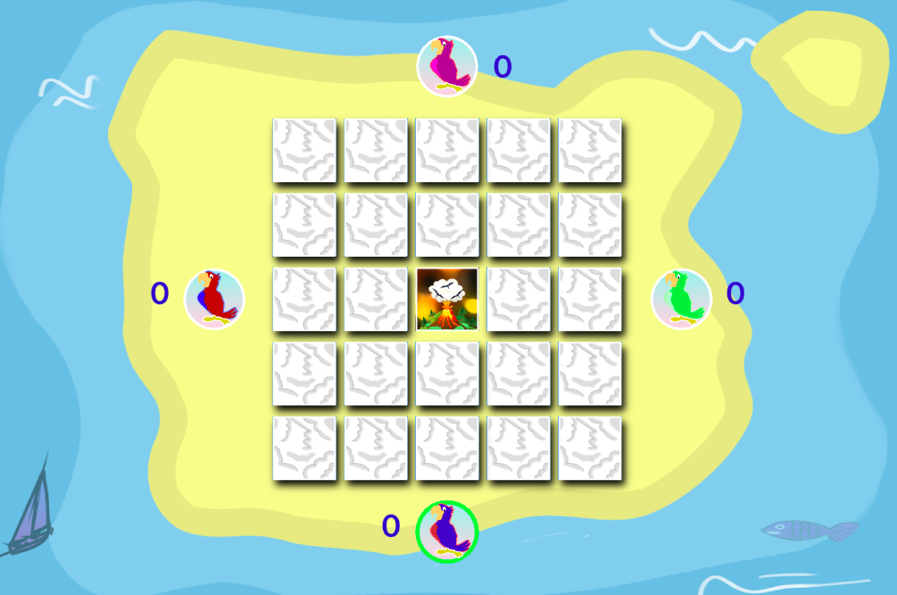


Slide 6



Slide 7


Slide 8


Slide 9



Slide 10


Slide 15


Slide 19
The App
Notes:
Thank you. Now I am to talk to you a bit about the inner mechanism of our model and how all of the pieces combined enables it to play the game accurately.

Slide 20
The Model
Notes:
Thank you. Now I am to talk to you a bit about the inner mechanism of our model and how all of the pieces combined enables it to play the game accurately.

Slide 21
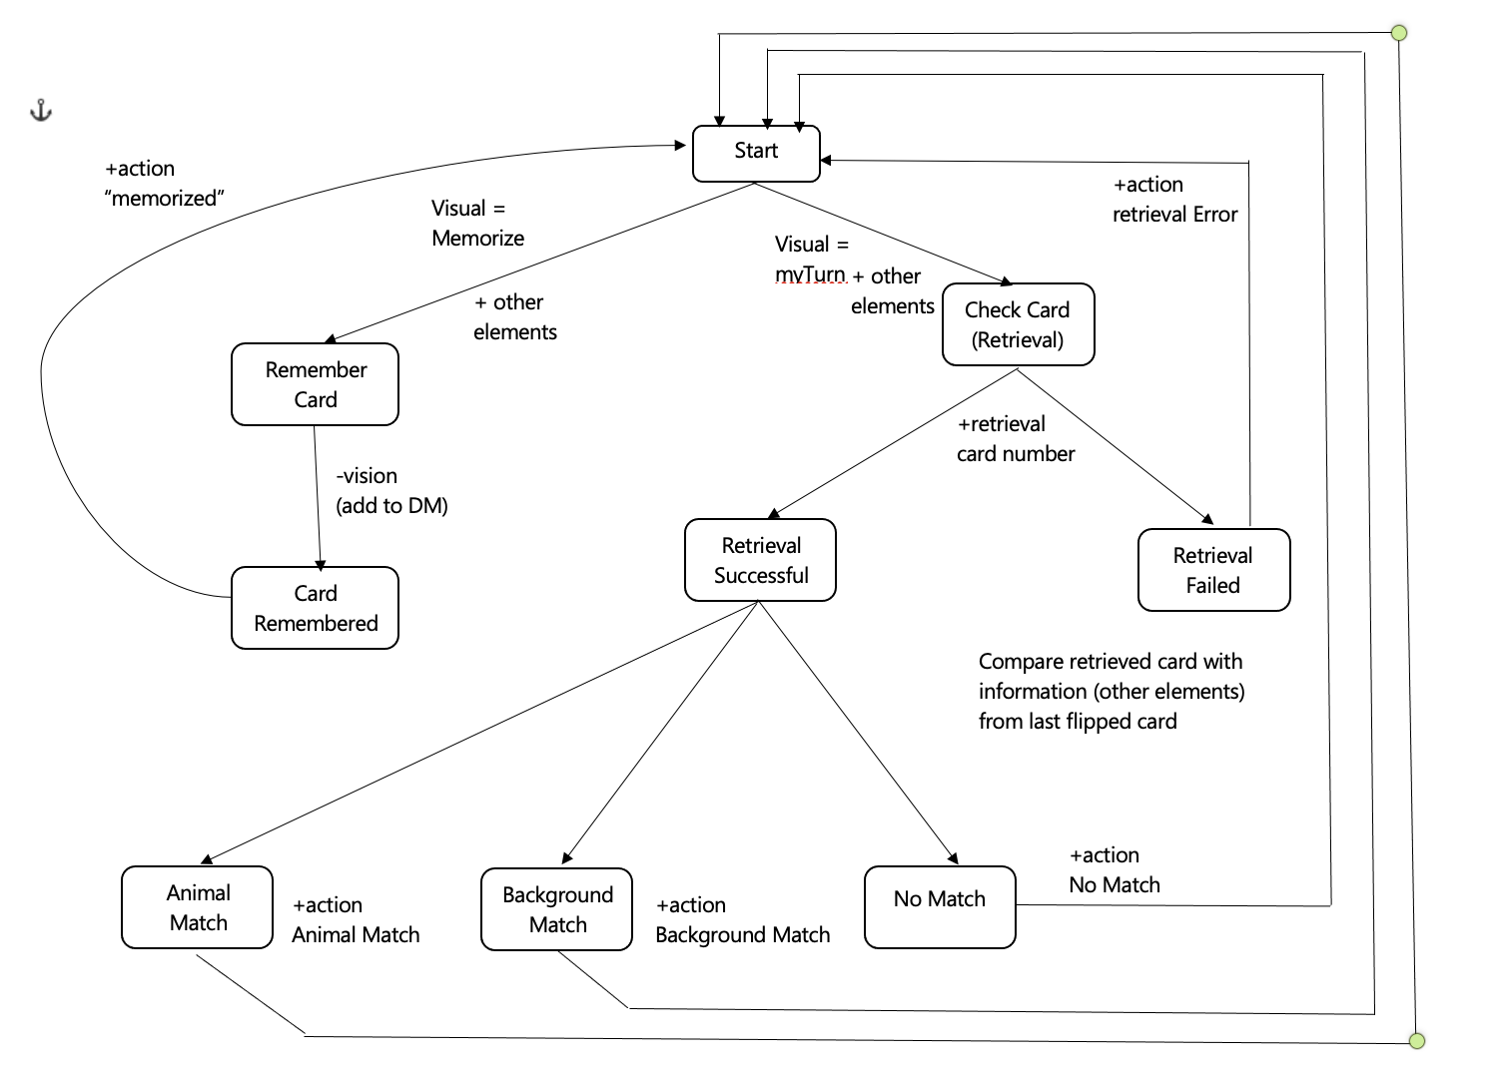
Notes:
As everything in the world, our model has a start point. There, the model gets initialized, and responds back to the code that initialization is complete.

Slide 22
Notes:
At this point, the model has only two paths. One is for memorizing cards that get flipped by the other players and is not yet the model’s turn.

Slide 23
Notes:
Or is the model’s turn and it has to check whether it can remember some card that matches the last flipped card.

Slide 24
Notes:
But for now, let’s focus on memorizing cards.

Slide 25
Notes:
That is done rather easy. In the visual buffer, I also have card information like background type and animal type. So by simply clearing the buffer, it gets into DM.

Slide 26
Notes:
Now the information got stored in the DM, and the model responds with an action, so that we know it memorized the card correctly.

Slide 27
Notes:
Now on the other side, it’s the model’s turn to flip a card, hence it will take all cards (in random order, to try to produce a more human-like experience) one by one.
For each card, it tries to do a retrieval request based on that card’s number (representing the card’s position).

Slide 28
Notes:
If the retrieval failed, the model will respond with an action, that way we know the model doesn’t have any information on that specific card.

Slide 29
Notes:
If the model managed to retrieve information about that specific card, it means it should have knowledge regarding the animal and the background.
So the model is now going to compare the retrieved information with the last flipped card information.

Slide 30
Notes:
Based on what kind of match is there, the model will respond accordingly.

Slide 31
Notes:
Therefore, through an action, the model will respond whether the card at some position it remember it matched the animal, the background or neither.

Slide 32
Strategy
Implemented:
When no match is found, turn a card that is not stored in the DM (”Negative knowledge”)

Slide 33
Strategy
Implemented:
When no match is found, turn a card that is not stored in the DM (“Negative knowledge”)
Vision:
Turn a card based on what has been already flipped and based on DM; get some sort of ranking of the match and decide on the best one, strategy wise

Slide 34
Thank you!
Notes:
Thank you. Now I am to talk to you a bit about the inner mechanism of our model and how all of the pieces combined enables it to play the game accurately.

